Slide 1
KPI Infographics
Is a great way to visualize information about users
Finance
$1.5M
Risk
$3.1M
Investment
$2.4M
Medium
Medium
High
Medium
Medium
High
Medium
Medium
High
Low
High
Low
High
Low
High
Business professionals like you connecting to share advice.
Business professionals like you connecting to share advice.
Business professionals like you connecting to share advice.

Slide 2
KPI Infographics
Is a great way to visualize information about users
Finance
$1.5M
Medium
Medium
High
35%
Risk
$2M
Low
High
Investment
$2.1M
Medium
Medium
High
Business professionals like you connecting to share advice. Business professionals like you connecting to share advice. Business professionals like you connecting to share advice. Business professionals like you connecting to share advice.
Low
High

Slide 3
KPI Infographics
Is a great way to visualize information about users
Build Status
$3M
Business professionals like you connecting to share advice.
Investment
$2M
Business professionals like you connecting to share advice.
Overview
$1M
Business professionals like you connecting to share advice.

Slide 4

KPI Infographics
Is a great way to visualize information about users
Build Status
Overview
Cash Flow
$4M
$5M
$6M
12%

Slide 5
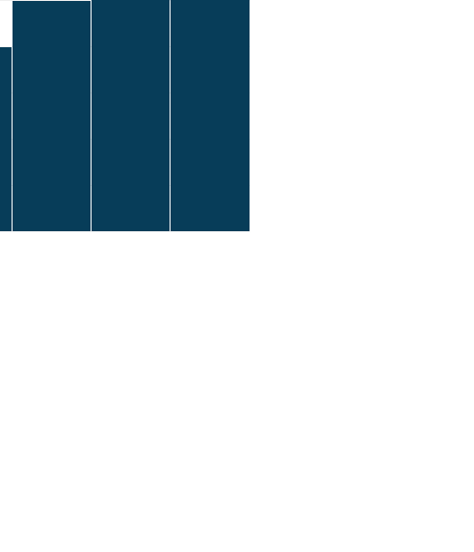
KPI Infographics
Is a great way to visualize information about users
12%
Build Status
Overview
Cash Flow
Attendance
$4M
$2M
$3M
$1M

Slide 6
KPI Infographics
Is a great way to visualize information about users
Build Status
-0.05%
Build Status
-0.05%
Build Status
-0.03%
Build Status
-0.03%

Slide 7
KPI Infographics
Is a great way to visualize information about users
10
100
10
100
10
100
2010
2015
2020
NPR Score
10
NPR Score
30
NPR Score
46
Source
Instagram
Source
Instagram
Source
Instagram
Sales Rep
Mary Smith
Sales Rep
Mary Smith
Sales Rep
Mary Smith

Slide 8
KPI Infographics
Is a great way to visualize information about users
$1.5M
+370
Men
$3M
+1236
Women

Slide 9
KPI Infographics
Is a great way to visualize information about users
Software Sales
Competitive Risk | Financial Risk | People Risk
10 | 35 | 24
4 | 9 | 5
7 | 12 | 16
12 | 54 | 37
450 | 740 | 290
10
100
Hardware Sales
Medium
Medium
High
Low
High

Slide 10
KPI Infographics
Is a great way to visualize information about users
Software
Sales
Attendance
Downloads

Slide 11
KPI Infographics
Is a great way to visualize information about users
$1.5M
12%
Business professionals like you connecting to share advice.
Business professionals like you connecting to share advice.
$3M
20%
Business professionals like you connecting to share advice.
Business professionals like you connecting to share advice.

Slide 12
KPI Infographics
Is a great way to visualize information about users
Software Sales
Download
$74,9239.23
Business professionals like you connecting to share advice.
Business professionals like you connecting to share advice.
Attendance

Slide 13
KPI Infographics
Is a great way to visualize information about users
Software Sales
Attendance
Business professionals like you connecting to share advice.
10
100
Download
Business professionals like you connecting to share advice.
10
100

Slide 14
KPI Infographics
Is a great way to visualize information about users
$1.5M
$2M
$3M
35%
65%
65%
35%
25%
75%
NPR
Score
Referral
Source
NPR
Score
Referral
Source
NPR
Score
Referral
Source
Competitive Risk | Financial Risk | People Risk
10 | 35 | 24
4 | 9 | 5
7 | 12 | 16
12 | 54 | 37
450 | 740 | 290

Slide 15
KPI Infographics
Is a great way to visualize information about users
NPR Score
10
68%
Source
Instagram
Sales Rep
Mary Smith
Competitive
Risk
Business professionals like you connecting to share advice.
NPR Score
10
Source
Instagram
$1.5M
Sales Rep
Mary Smith

Slide 16
KPI Infographics
Is a great way to visualize information about users
Competitive Risk | Financial Risk
34 | 570
490 | 28
10 | 1950
2740 | 470
8 | 591
NPR Score
10
$1.5M
Source
Instagram
Sales Rep
Mary Smith

Slide 17
KPI Infographics
Is a great way to visualize information about users
-10%
Business professionals like you connecting to share advice.
NPR Score
10%
NPR Score
10%
+25%
+18%
Source
20%
Source
20%
Business professionals like you connecting to share advice.
Business professionals like you connecting to share advice.
Sales Rep
30%
Sales Rep
30%

Slide 18
KPI Infographics
Is a great way to visualize information about users
$1.5M
NPR Score
10
$2.3M
Business professionals like you connecting to share advice.
Source
Instagram
Business professionals like you connecting to share advice.
Sales Rep
John Smith

Slide 19
KPI Infographics
Is a great way to visualize information about users
Sales
Performance
Investment
+23%
+17%
+9%
Business professionals like you connecting to share advice.
Business professionals like you connecting to share advice.
Business professionals like you connecting to share advice.

Slide 20
KPI Infographics
Is a great way to visualize information about users
+68%
Competitive Risk
Business professionals like you connecting to share advice.
+32%
Competitive Risk
Business professionals like you connecting to share advice.

